Slide 1
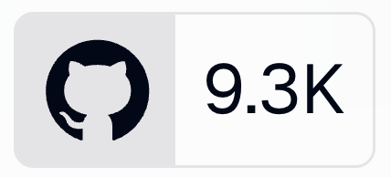
Clickhouse Meetup March 2025

Slide 2






Langfuse is the open source LLM Engineering Platform
What is Langfuse?
Ingest full context of your LLM application via SDKs and integrations
Build a rich dataset of your app’s performance and use it downstream (e.g. to fine-tune, debug) + dashboards, analytics on your app
Iterate and improve on your LLM application with Prompt Management, Playground, evals (human & model-based), datasets (testing) and more

Slide 3
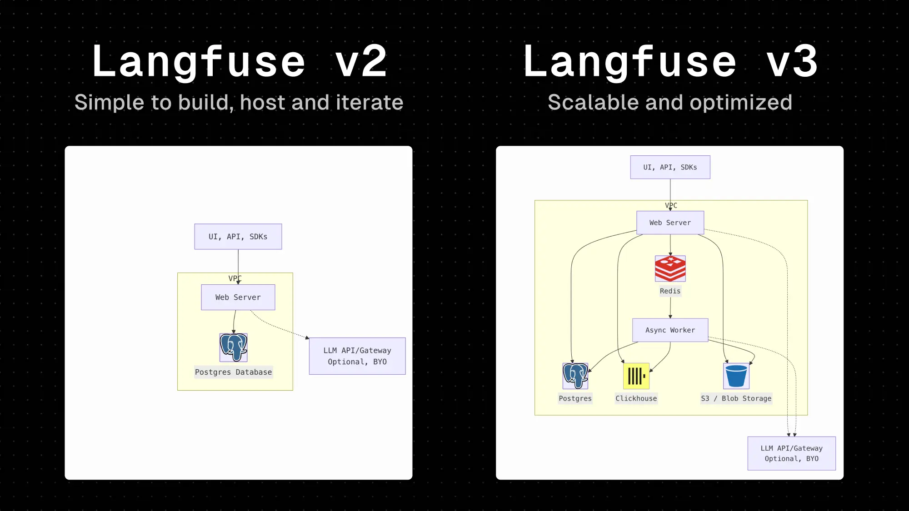

Slide 4
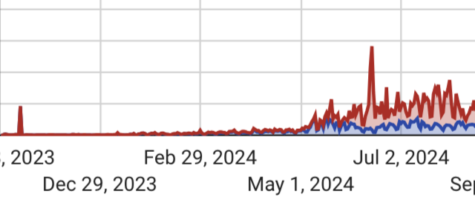
Things started to break last spring / summer
Billions of rows
Large i/o
Updatable traces
Different UIs for the same data
Single traces as well as charts, dashboards and metrics api that aggregate hundreds of millions of traces
Why Clickhouse?
Modern, High trust & Scalable
Role Models (Posthog, BetterStack, LLMOps)
CH-Cloud: Ease, Support, Regions, Backups

Slide 6

How to communicate / manage change with thousands of self hosters?
Early, public, transparent and frequent communication
Mailing list
“Focus Group” & Release Candidate
Background Migration (visible in UI, robust)
High quality Docs, Frequent updates in Forums, high-touch support

Slide 7
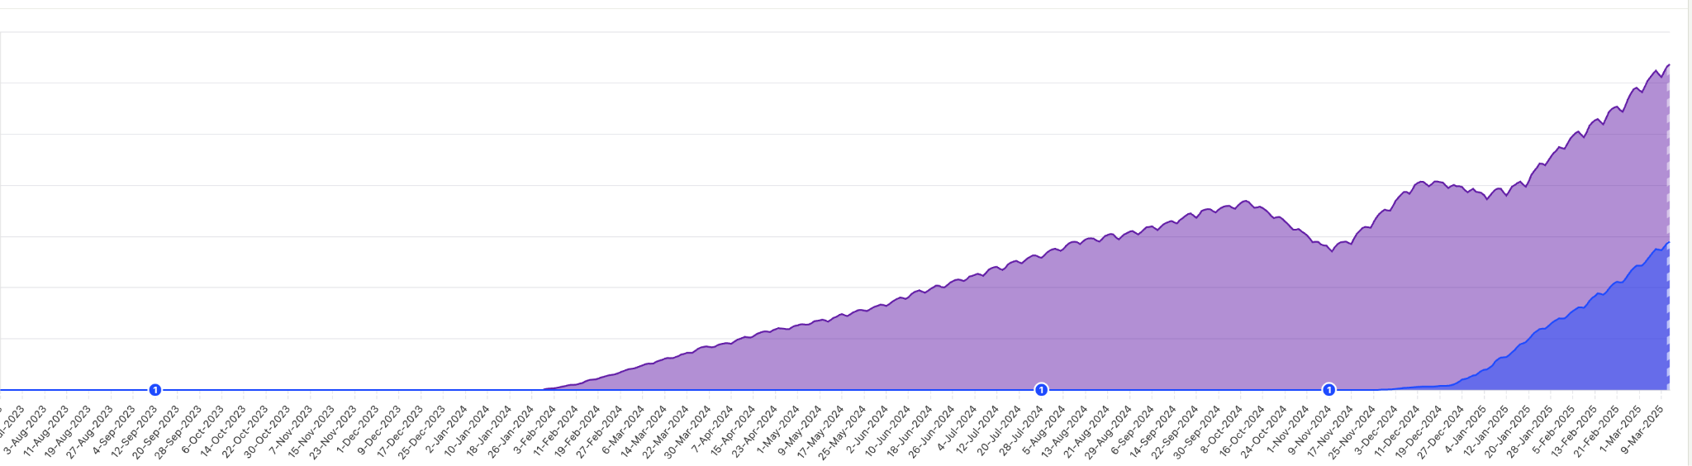
Early adoption is promising!
V3 Launch

Slide 8
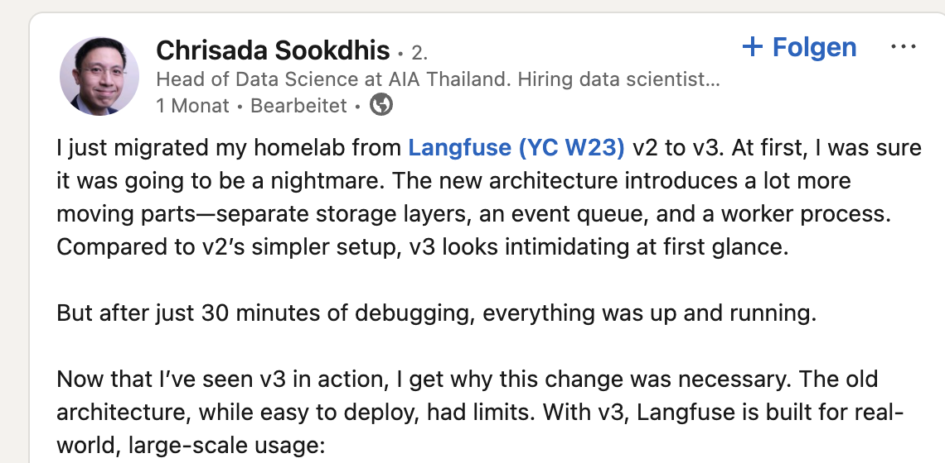
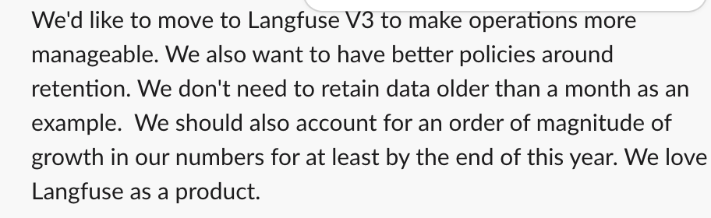
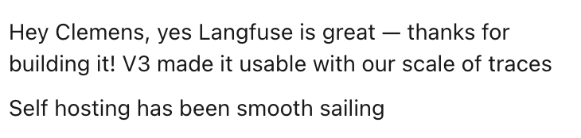
Early adoption is promising!

Slide 9
Rolling out Clickhouse in GTM
Concerns: New set up is more involved, some users are hesitant to onboard/manage a new DB
Solution: Making It Easy to find the right deployment model:
Small Scale & PoC: Docker Compose
Production:
Helm chart for Kubernetes
Deployment templates for Hyperscalers
Managed:
Clickhouse Cloud, Clickhouse BYOC (attractive in Enterprise)
Langfuse Cloud (self selection)

Slide 10


Thank you & Learn more
🧑‍🏫 Langfuse Clickhouse Blog Post —>
⭐️ github.com/langfuse/langfuse
Clemens Rawert
co-founder, Langfuse
clemens@langfuse.com

Slide 11
Notes:
Demo
https://docs.google.com/document/d/1xF6eTYYf5v8HwLAEWigFPK-CItDX_oJ3fAtQtV1ahRY/edit?usp=sharing

